Slide 1


Serverless Holiday Hackathon 2023

Slide 2



Our plans for today
About Serverless Guru
Hackathon 101
Demo time!
Q & A

Slide 3
About Serverless Guru
Your Guide to Serverless Adopt. Migrate. Build.

Slide 4
Our Company
We love to take on challenges, face the unknown, and be on the forefront of serverless innovation.
Helping companies and people realize their full potential gives us energy.
Speak to a Guru today!

Slide 5
Hackathon 101
Everything you need to know
to get the most out of the challenge

Slide 6
Challenge
Full Stack Holiday-themed AI Chatbot
This Serverless Christmas Challenge is not just another Hackathon; it's a festive endeavor where you, as a participant, will develop a Full Stack Holiday-themed AI Chatbot 🤖🎄

Slide 7
Event Timeline
Announcement Webinar
Join us as we unwrap all the magical details, rules, and prizes! ✨There will also be a live Q&A so you'll be as prepared as Santa on Christmas Eve!
LLM Overview Webinar - Cyril Bandolo
Join us to discover everything you need to know about LLMs and a brief introduction on how to use them. Webinar with the one and only Cyril Bandolo - AWS HERO
Dec. 01
Dec. 08
Nov. 24
Dec. 01
Hackathon Begins
The workshop is now open! Whether you're flying solo or as a trio of tech enthusiasts, it's time to start building!
Let’s talk Tech - Webinar
Join and be part of the discussion. In this webinar we’ll go over the possible tech-stacks that we’d recommend. Special Guest speaker to deepdive on Langchain.

Slide 8
Event Timeline
Demo App Deep Dive - Webinar
Struggling with the challenge? Join us while we do a deep dive into our demo application and how we developed everything.
Winners announced
Ho ho who won it all? The winners will be notified and announced!
Dec. 17
Jan. 16
Dec. 15
Jan. 12
Project Submission Deadline
Make your app and check it twice! It's project submission day! (Submissions due by 11:59 pm PST)
Closing Webinar
Show and tell time! Witness the culmination of hard work, creativity, and technical prowess as the winners showcase their final projects.

Slide 9
Project Submissions
December 17, 2023 (Submissions due by 11:59 pm PST)
Article
Don't be afraid to write a lengthier article! It's better to cover all the aspects of your project rather than leave some features outside!
Demo Video

Slide 10
Project Submissions
December 17, 2023 (Submissions due by 11:59 pm PST)
Demo Video
If possible, share a demo (video format is better) of your final project. Your video should be no longer than 5 minutes

Slide 11
Project Submissions
December 17, 2023 (Submissions due by 11:59 pm PST)
Public Repository
This facilitates fair and thorough evaluation by judges, ensuring that the submitted project aligns with the hackathon's guidelines and criteria

Slide 12

Prizes
$1,500 USD
$500 USD
$3,000 USD

Slide 13
Evaluation Criteria
BE Architecture
Evaluating the structural integrity, scalability, and efficiency of the back-end design.
Article Completeness
Reviewing the thoroughness, clarity, and comprehensiveness of the accompanying article.
Real-World Applicability
Assessing the practicality and usefulness of the developed project and its infrastructure in real-life scenarios.
Code Quality
Emphasis on best practices, clean and organized coding patterns, adherence to proper naming conventions, and correct lining.

Slide 14
Rules
Eligibility
Judging Criteria
Intellectual Property
1
2
3
Open to all with a passion for innovation. Participation indicates acceptance of our terms.
Originality (30%), Innovation (35%), Practical Implementation (35%).
Your work, your rights. All submissions remain your intellectual property.

Slide 15
Rules
Privacy
Conduct
Compliance
4
5
6
We value your privacy. Personal data is used only for event-related promotion.
By entering, participants agree to indemnify the sponsor from any liability.
Adheres to all legal standards. The sponsor may modify or cancel the Hackathon if required.

Slide 16
Demo Time
Make your presentations more fun.
Make good use of illustrations and other elements to
compose your layout.

Slide 17


Time for
Demo.

Slide 18
Questions & Answers
Make your presentations more fun.
Make good use of illustrations and other elements to
compose your layout.

Slide 19
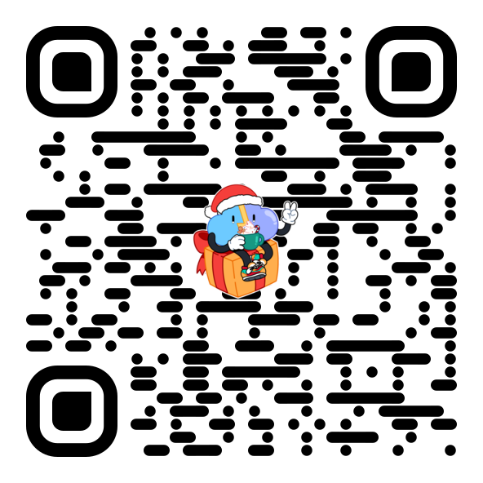
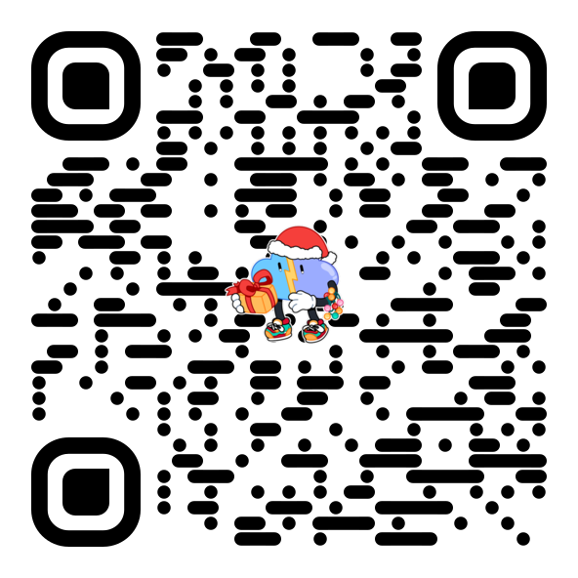
Thank you!
Join our discord Server!
Sign up for the challenge!

